Slide 1
Object Detection
Detecting and Describing Image by Machine Learning

Slide 2
Team Members
Divyanshi Agarwal
Ayush Maheshwari
Harsh Nain
Kundan Jha

Slide 3
Introduction
Human brains are very advance. When we’re shown an image, our brain instantly recognizes the objects contained in it.
On the other hand machine are not that smart. It takes a lot of time and training data for a machine to identify these objects.
But with the recent advances in hardware and deep learning, this computer vision field has become a whole lot easier and more intuitive.
Computers and machine can more accurately identify objects now.
Object recognition is a computer vision technique for identifying objects in images or videos.

Slide 4
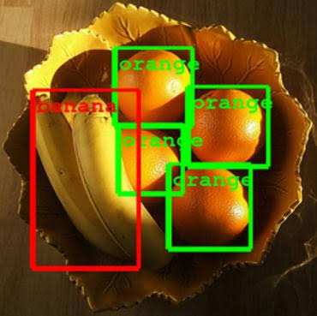
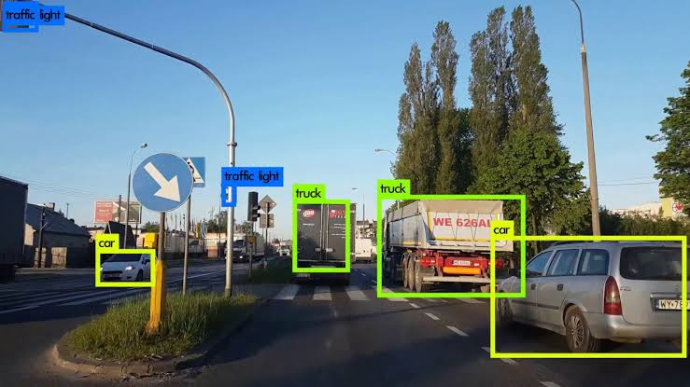

Examples of object detection

Slide 5

Machine learning in object detection
CNN or Convolutional Neural Networks
A Convolutional Neural Network is a Deep Learning algorithm which can take in an input image, assign importance to various aspects/objects in the image and be able to differentiate one from the other.
An image is nothing but a matrix of pixel values
A CNN is able to successfully capture the Spatial and Temporal dependencies in an image through the application of relevant filters.

Slide 6
Algorithm used in object detection
RCNN or Region Based Convolution Neural Network:
RCNN algorithm proposes a bunch of boxes in the image and checks if any of these boxes contain any object. RCNN uses selective search to extract these boxes from an image (these boxes are called regions).
YOLO or You Only Look Once:
YOLO divides each image into a grid of S x S and each grid predicts N bounding boxes and confidence. The confidence reflects the accuracy of the bounding box and whether the bounding box actually contains an object(regardless of class).
SDD or Single Shot Detector(SSD):
SSD runs a convolutional network on input image only once and calculates a feature map. Now, we run a small 3×3 sized convolutional kernel on this feature map to predict the bounding boxes and classification probability

Slide 7
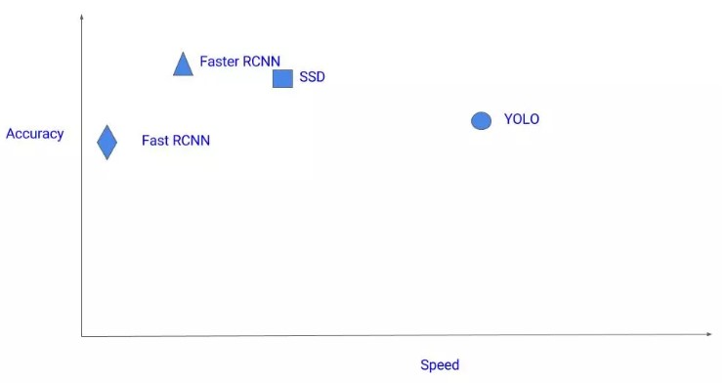
Accuracy vs Speed graph

Slide 8
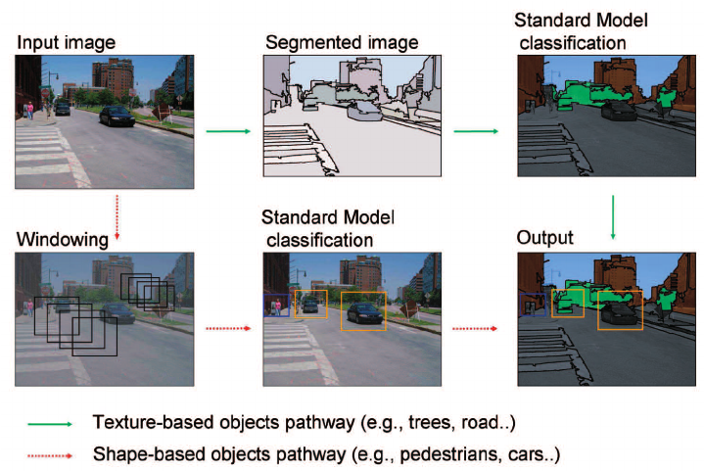
Process of detection

Slide 9
Approach to The Project
ImageAI
ImageAI is an easy to use Computer Vision Python library that empowers developers to easily integrate state-of-the-art Artificial Intelligence features into their new and existing applications and systems. It is used by thousands of developers, students, researchers, tutors and experts in corporate organizations around the world.
Utility provided by ImageAI are image recognition, object detection, Video Detection and Analysis and Custom Recognition Training.
ImageAI library make the use of Google’s TensorFlow for the purpose.

Slide 10
TensorFlow
TensorFlow is a free and open-source software library for dataflow and differentiable programming across a range of tasks. It is a symbolic math library, and is also used for machine learning applications.
TensorFlow was developed by the Google Brain team for internal Google use. It was released under the Apache License 2.0 on November 9, 2015.
ImageAI make the use of TensorFlow Object Detection API for the detection of objects in mages and videos.

Slide 11
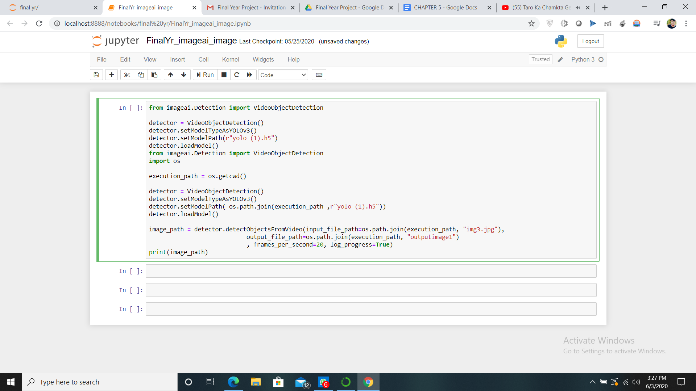
Source code using image ai for images

Slide 12

Image before Running the Algorithm

Slide 13
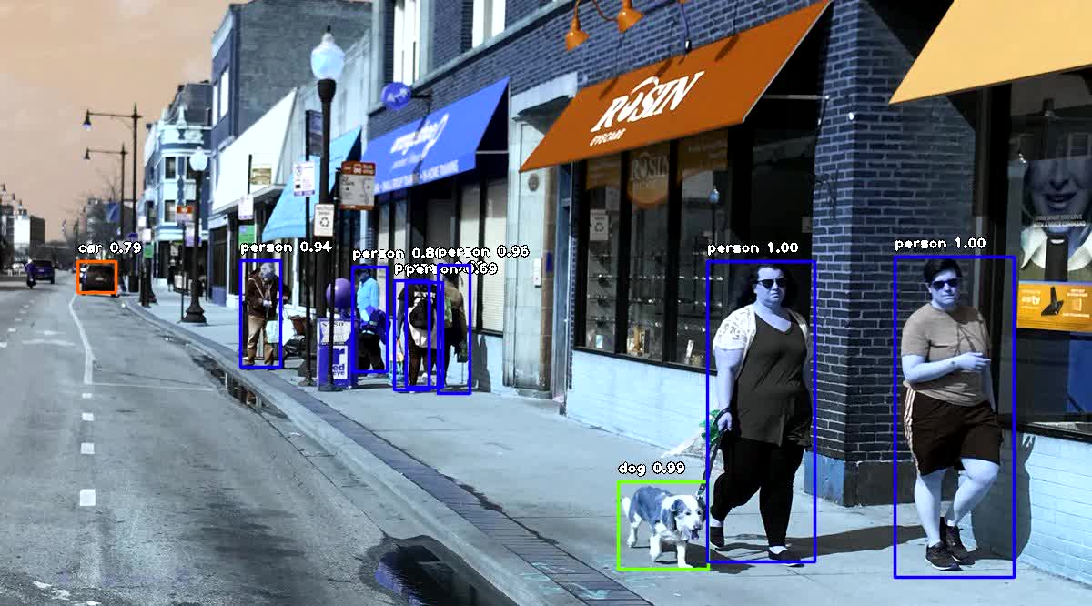
Image after running the algorithm

Slide 14
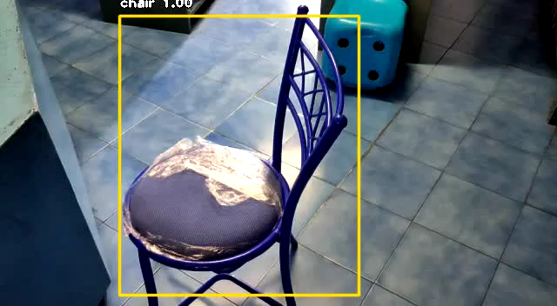
Object detection example on video

Slide 15
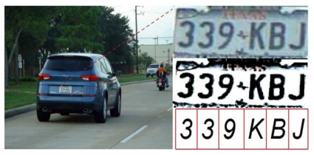
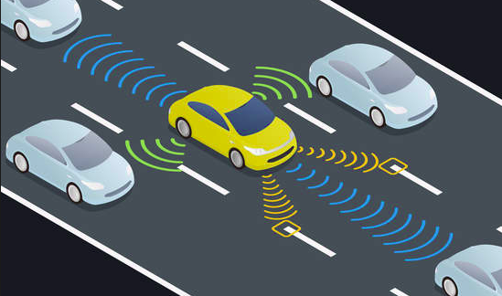
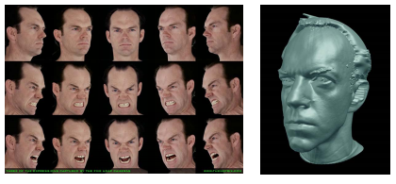
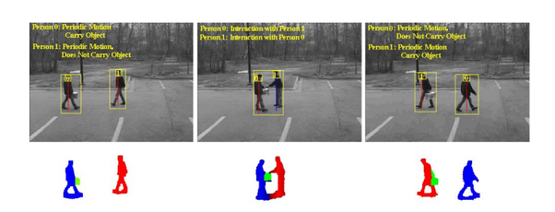
Applications of object detection
OPTICAL CHARACTER RECOGNITION
SELF DRIVING CARS
FACE DETECTION AND FACE RECOGNITION
ACTIVITY RECOGNITION

Slide 16
Conclusion
Object detection is a key ability for most computer and robot vision system.
Although great progress has been observed in the last years, and some existing techniques are now part of many consumer electronics or have been integrated in assistant driving technologies.
We are still far from achieving human-level performance, in particular in terms of open-world learning.
As mobile robots, and in general autonomous machines, are starting to be more widely deployed .
Finally, we need to consider that we will need object detection systems for nano-robots or for robots that will explore areas that have not been seen by humans. In such cases, a real-time open-world learning ability will be critical.

Slide 17
Thank You

